Slide 1


INTRODUCTION TO
CORPORATE FINANCE
Laurence Booth • W. Sean Cleary
Chapter 15 – Mergers and Acquisitions
Prepared by
Ken Hartviksen

Slide 2
CHAPTER 15
Mergers and Acquisitions

Slide 3
Lecture Agenda
Learning Objectives
Important Terms
Types of Takeovers
Securities Legislation
Friendly versus hostile takeovers
Motivations for Mergers and Acquisitions
Valuation Issues
Accounting for Acquisitions
Summary and Conclusions
  Concept Review Questions

Slide 4
Learning Objectives
The different types of acquisitions
How a typical acquisition proceeds
What differentiates a friendly from a hostile acquisition
Different forms of combinations of firms
Where to look for acquisition gains
How accounting may affect the acquisition decision

Slide 5
Important Chapter Terms
Acquisition
Amalgamation
Arbs
Asset purchase
Break fee
Cash transaction
Confidentiality agreement
Conglomerate merger
Creeping takeovers
Cross-border (international) M&A
Data room
Defensive tactic
Due diligence
Extension M&A
Fair market value
Fairness opinion
Friendly acquisition
Geographic roll-up
Going private transaction/issuer bid
Goodwill
Horizontal merger
Hostile takeover
Letter of intent
Management buyouts (MBOs)/leveraged buyouts (LBOs)
Merger

Slide 6
Important Chapter Terms…
No-shop clause
Offering memorandum
Over-capacity M&A
Proactive models
Purchase method
Selling the crown jewels
Share transaction
Shareholders rights plan/poison pill
Synergy
Takeover
Tender
Tender offer
Vertical merger
White knight

Slide 7
Types of Takeovers
Mergers and Acquisitions

Slide 8
Types of Takeovers
General Guidelines
Takeover
  The transfer of control from one ownership group to another.
Acquisition
  The purchase of one firm by another
Merger
  The combination of two firms into a new legal entity
  A new company is created
  Both sets of shareholders have to approve the transaction.
Amalgamation
  A genuine merger in which both sets of shareholders must approve the transaction
  Requires a fairness opinion by an independent expert on the true value of the firm’s shares when a public minority exists

Slide 9
Types of Takeovers
How the Deal is Financed
Cash Transaction
  The receipt of cash for shares by shareholders in the target company.
Share Transaction
  The offer by an acquiring company of shares or a combination of cash and shares to the target company’s shareholders.
Going Private Transaction (Issuer bid)
  A special form of acquisition where the purchaser already owns a majority stake in the target company.

Slide 10
Securities Laws Pertaining to Takeovers
Mergers and Acquisitions

Slide 11
General Intent of the Legislation
Transparency – Information Disclosure
To ensure complete and timely information be available to all parties (especially minority shareholders) throughout the process while at the same time not letting this requirement stall the process unduly.
Fair Treatment
To avoid oppression or coercion of minority shareholders.
To permit competing bids during the process and not have the first bidder have special rights. (In this way, shareholders have the opportunity to get the greatest and fairest price for their shares.)
To limit the ability of a minority to frustrate the will of a majority. (minority squeeze out provisions)

Slide 12
Exempt Takeovers
Private companies are generally exempt from provincial securities legislation.
Public companies that have few shareholders in one province may be subject to takeover laws of another province where the majority of shareholders reside.

Slide 13
Exemption from Takeover Requirements for Control Blocks
Purchase of securities from 5 or fewer shareholders are permitted without a tender offer requirement provided the premium over the market price is less than 15%

Slide 14
Creeping Takeovers
The 5% Rule
The 5% rule
Normal course tender offer is not required as long as no more than 5% of the outstanding shares are purchased through the exchange over a one-year period of time.
This allows creeping takeovers where the company acquires the target over a long period of time.

Slide 15
Securities Legislation
Critical Shareholder Percentages
  10%: Early Warning
    When a shareholder hits this point a report is sent to OSC
    This requirement alters other shareholders that a potential acquisitor is accumulating a position (toehold) in the firm.
  20%: Takeover Bid
    Not allowed further open market purchases but must make a takeover bid
    This allows all shareholders an equal opportunity to tender shares and forces equal treatment of all at the same price.
    This requirement also forces the acquisitor into disclosing intentions publicly before moving to full voting control of the firm.

Slide 16
Securities Legislation
Critical Shareholder Percentages Continued …
  3. 50.1%: Control
    Shareholder controls voting decisions under normal voting (simple majority)
    Can replace board and control management
  4. 66.7%: Amalgamation
    The single shareholder can approve amalgamation proposals requiring a 2/3s majority vote (supermajority)
  5. 90%: Minority Squeeze-out
    Once the shareholder owns 90% or more of the outstanding stock minority shareholders can be forced to tender their shares.
    This provision prevents minority shareholders from frustrating the will of the majority.

Slide 17
The Takeover Bid Process
Moving Beyond the 20% Threshold
Takeover circular sent to all shareholders.
Target has 15 days to circulate letter to shareholders with the recommendation of the board of directors to accept/reject.
Bid must be open for 35 days following public announcement.
Shareholders tender to the offer by signing authorizations.
A Competing bid automatically increases the takeover window by 10 days and shareholders during this time can with drawn authorization and accept the competing offer.

Slide 18
The Takeover Bid Process
Prorated Settlement and Price
Takeover bid does not have to be for 100 % of the shares.
Tender offer price cannot be for less than the average price that the acquirer bought shares in the previous 90 days. (prohibits coercive bids)
If more shares are tendered than required under the tender, everyone who tendered shares will get a prorated number purchased.

Slide 19
Friendly Acquisition
  The acquisition of a target company that is willing to be taken over.
  Usually, the target will accommodate overtures and provide access to confidential information to facilitate the scoping and due diligence processes.

Slide 20
Friendly Acquisitions
The Friendly Takeover Process
  1. Normally starts when the target voluntarily puts itself into play.
    Target uses an investment bank to prepare an offering memorandum
      May set up a data room and use confidentiality agreements to permit access to interest parties practicing due diligence
      A signed letter of intent signals the willingness of the parties to move to the next step – (usually includes a no-shop clause and a termination or break fee)
      Legal team checks documents, accounting team may seek advance tax ruling from CRA
      Final sale may require negotiations over the structure of the deal including:
        Tax planning
        Legal structures
  2. Can be initiated by a friendly overture by an acquisitor seeking information that will assist in the valuation process.
  (See Figure 15 -1 for a Friendly Acquisition timeline)

Slide 21
Friendly Acquisition
15-1 FIGURE
Friendly Acquisition
Information
memorandum
Confidentiality
agreement
Main due
diligence
Ratified
Sign letter
of intent
Final sale
agreement
Approach
target

Slide 22
Friendly Takeovers
Structuring the Acquisition
In friendly takeovers, both parties have the opportunity to structure the deal to their mutual satisfaction including:
    Taxation Issues – cash for share purchases trigger capital gains so share exchanges may be a viable alternative
    Asset purchases rather share purchases that may:
      Give the target firm cash to retire debt and restructure financing
      Acquiring firm will have a new asset base to maximize CCA deductions
      Permit escape from some contingent liabilities (usually excluding claims resulting from environmental lawsuits and control orders that cannot severed from the assets involved)
    Earn outs where there is an agreement for an initial purchase price with conditional later payments depending on the performance of the target after acquisition.

Slide 23
Hostile Takeovers
  A takeover in which the target has no desire to be acquired and actively rebuffs the acquirer and refuses to provide any confidential information.
  The acquirer usually has already accumulated an interest in the target (20% of the outstanding shares) and this preemptive investment indicates the strength of resolve of the acquirer.

Slide 24
Hostile Takeovers
The Typical Process
The typical hostile takeover process:
  Slowly acquire a toehold (beach head) by open market purchase of shares at market prices without attracting attention.
  File statement with OSC at the 10% early warning stage while not trying to attract too much attention.
  Accumulate 20% of the outstanding shares through open market purchase over a longer period of time
  Make a tender offer to bring ownership percentage to the desired level (either the control (50.1%) or amalgamation level (67%)) - this offer contains a provision that it will be made only if a certain minimum percentage is obtained.
During this process the acquirer will try to monitor management/board reaction and fight attempts by them to put into effect shareholder rights plans or to launch other defensive tactics.

Slide 25
Hostile Takeovers
Capital Market Reactions and Other Dynamics
Market clues to the potential outcome of a hostile takeover attempt:
  Market price jumps above the offer price
    A competing offer is likely or
    The bid price is too low
  Market price stays close to the offer price
    The offer price is fair and the deal will likely go through
  Little trading in the shares
    A bad sign for the acquirer because shareholders are reluctant to sell.
  Great deal of trading in the shares
    Large numbers of shares being sold from normal investors to arbitrageurs (arbs) who are, themselves building a position to negotiate an even bigger premium for themselves by coordinating a response to the tender offer.

Slide 26
Hostile Takeovers
Defensive Tactics
Shareholders Rights Plan
  Known as a poison pill or deal killer
  Can take different forms but often
    Gives non-acquiring shareholders get the right to buy 50 percent more shares at a discount price in the event of a takeover.
Selling the Crown Jewels
  The selling of a target company’s key assets that the acquiring company is most interested in to make it less attractive for takeover.
  Can involve a large dividend to remove excess cash from the target’s balance sheet.
White Knight
  The target seeks out another acquirer considered friendly to make a counter offer and thereby rescue the target from a hostile takeover

Slide 27
Motives for Takeovers
Mergers and Acquisitions

Slide 28
Classifications Mergers and Acquisitions
Horizontal
  A merger in which two firms in the same industry combine.
  Often in an attempt to achieve economies of scale and/or scope.
Vertical
  A merger in which one firm acquires a supplier or another firm that is closer to its existing customers.
  Often in an attempt to control supply or distribution channels.
Conglomerate
  A merger in which two firms in unrelated businesses combine.
  Purpose is often to ‘diversify’ the company by combining uncorrelated assets and income streams
Cross-border (International) M&As
  A merger or acquisition involving a Canadian and a foreign firm a either the acquiring or target company.

Slide 29
Mergers and Acquisition Activity
M&A activity seems to come in ‘waves’ through the economic cycle domestically, or in response to globalization issues such as:
  Formation and development of trading zones or blocks (EU, North America Free Trade Agreement
  Deregulation
  Sector booms such as energy or metals
Table 15 -1 on the following slide depicts major M&A waves since the late 1800s.

Slide 30
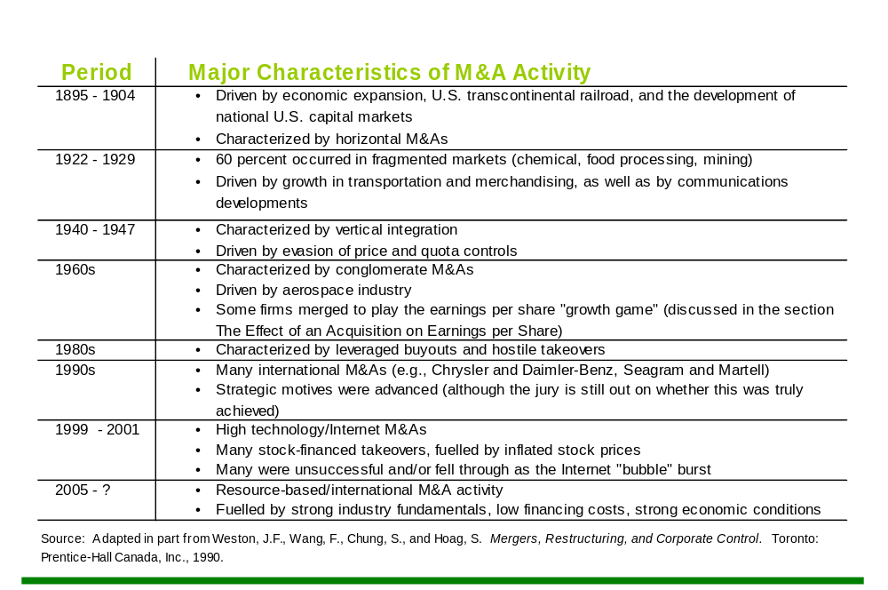
M&A Activity in Canada

Slide 31
Motivations for Mergers and Acquisitions
Creation of Synergy Motive for M&As
The primary motive should be the creation of synergy.
Synergy value is created from economies of integrating a target and acquiring a company; the amount by which the value of the combined firm exceeds the sum value of the two individual firms.

Slide 32
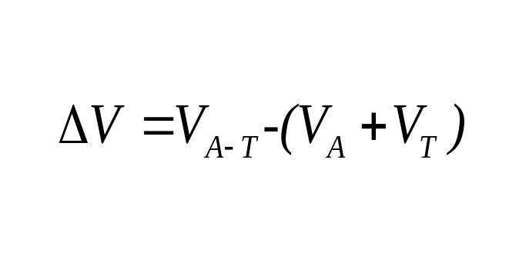
Creation of Synergy Motive for M&As
Synergy is the additional value created (∆V) :
Where:
  V_{T} = the pre-merger value of the target firm
  V_{A - T} = value of the post merger firm
  V_{A} = value of the pre-merger acquiring firm
[ 15-1]

Slide 33
Value Creation Motivations for M&As
Operating Synergies
Operating Synergies
  Economies of Scale
    Reducing capacity (consolidation in the number of firms in the industry)
    Spreading fixed costs (increase size of firm so fixed costs per unit are decreased)
    Geographic synergies (consolidation in regional disparate operations to operate on a national or international basis)
  Economies of Scope
    Combination of two activities reduces costs
  Complementary Strengths
    Combining the different relative strengths of the two firms creates a firm with both strengths that are complementary to one another.

Slide 34
Value Creation Motivations for M&A
Efficiency Increases and Financing Synergies
Efficiency Increases
  New management team will be more efficient and add more value than what the target now has.
  The combined firm can make use of unused production/sales/marketing channel capacity
Financing Synergy
  Reduced cash flow variability
  Increase in debt capacity
  Reduction in average issuing costs
  Fewer information problems

Slide 35
Value Creation Motivations for M&A
Tax Benefits and Strategic Realignments
Tax Benefits
  Make better use of tax deductions and credits
    Use them before they lapse or expire (loss carry-back, carry-forward provisions)
    Use of deduction in a higher tax bracket to obtain a large tax shield
    Use of deductions to offset taxable income (non-operating capital losses offsetting taxable capital gains that the target firm was unable to use)
    New firm will have operating income to make full use of available CCA.
Strategic Realignments
  Permits new strategies that were not feasible for prior to the acquisition because of the acquisition of new management skills, connections to markets or people, and new products/services.

Slide 36
Managerial Motivations for M&As
Managers may have their own motivations to pursue M&As. The two most common, are not necessarily in the best interest of the firm or shareholders, but do address common needs of managers
    Increased firm size
      Managers are often more highly rewarded financially for building a bigger business (compensation tied to assets under administration for example)
      Many associate power and prestige with the size of the firm.
    Reduced firm risk through diversification
      Managers have an undiversified stake in the business (unlike shareholders who hold a diversified portfolio of investments and don’t need the firm to be diversified) and so they tend to dislike risk (volatility of sales and profits)
      M&As can be used to diversify the company and reduce volatility (risk) that might concern managers.

Slide 37
Empirical Evidence of Gains through M&As
Target shareholders gain the most
  Through premiums paid to them to acquire their shares
    15 – 20% for stock-finance acquisitions
    25 – 30% for cash-financed acquisitions (triggering capital gains taxes for these shareholders)
  Gains may be greater for shareholders will to wait for ‘arbs’ to negotiate higher offers or bidding wars develop between multiple acquirers.
Between 1995 and 2001, 302 deals worth US$500.
  61% lost value over the following year
  The biggest losers were deals financed through shares which lost an average 8%.

Slide 38
Empirical Evidence of Gains through M&As
Shareholder Value at Risk (SVAR)
Shareholder Value at Risk (SVAR)
  Is the potential in an M&A that synergies will not be realized or that the premium paid will be greater than the synergies that are realized.
    When using cash, the acquirer bears all the risk
    When using share swaps, the risk is borne by the shareholders in both companies
SVAR supports the argument that firms making cash deals are much more careful about the acquisition price.

Slide 39
Valuation Issues in Corporate Takeovers
Mergers and Acquisitions

Slide 40
Valuation Issues
What is Fair Market Value?
Fair market value (FMV) is the highest price obtainable in an open and unrestricted market between knowledgeable, informed and prudent parties acting at arm’s length, with neither party being under any compulsion to transact.
Key phrases in this definition:
    Open and unrestricted market (where supply and demand can freely operate – see Figure 15 -2 on the following slide)
    Knowledgeable, informed and prudent parties
    Arm’s length
    Neither party under any compulsion to transact.

Slide 41
Valuation Issues
Valuation Framework
15-2 FIGURE
Demand
Supply
P
S1
B1
P*
Q

Slide 42
Valuation Issues
Types of Acquirers
  Determining fair market value depends on the perspective of the acquirer. Some acquirers are more likely to be able to realize synergies than others and those with the greatest ability to generate synergies are the ones who can justify higher prices.
Types of acquirers and the impact of their perspective on value include:
  Passive investors – use estimated cash flows currently present
  Strategic investors – use estimated synergies and changes that are forecast to arise through integration of operations with their own
  Financials – valued on the basis of reorganized and refinanced operations
  Managers – value the firm based on their own job potential and ability to motivate staff and reorganize the firm’s operations. MBOs and LBOs
Market pricing will reflect these different buyers and their importance at different stages of the business cycle.

Slide 43
Market Pricing Approaches
Reactive Pricing Approaches
  Models reacting to general rules of thumb and the relative pricing compared to other securities
  Multiples or relative valuation
  Liquidation or breakup values
Proactive Models
  A valuation method to determine what a target firm’s value should be based on future values of cash flow and earnings
  Discounted cash flow (DCF) models

Slide 44
Reactive Approaches
Valuation Using Multiples
1. Find appropriate comparators
  Individual firm that is highly comparable to the target
  Industry average if appropriate
2. Adjust/normalize the data (income statement and balance sheet) for differences between target and comparator including:
  Accounting differences
    LIFO versus FIFO
    Accelerated versus straight-line depreciation
    Age of depreciable assets
    Pension liabilities, etc.
  Different capital structures
3. Calculate a variety of ratios for both the target and the comparator including:
  Price-earnings ratio (trailing)
  Value/EBITDA
  Price/Book Value
  Return on Equity
4. Obtain a range of justifiable values based on the ratios

Slide 45
Reactive Approaches
Liquidation Valuation
Estimate the liquidation value of current assets
Estimate the present value of tangible assets
Subtract the value of the firm’s liability from estimated liquidation value of all the firm’s assets = liquidation value of the firm.
This approach values the firm based on existing assets and is not forward looking.

Slide 46
The Proactive Approach
Discounted Cash Flow Valuation
The key to using the DCF approach to price a target firm is to obtain good forecasts of free cash flow
Free cash flows to equity holders represents cash flows left over after all obligations, including interest payments have been paid.
DCF valuation takes the following steps:
  Forecast free cash flows
  Obtain a relevant discount rate
  Discount the forecast cash flows and sum to estimate the value of the target
(See Equation 15 – 2 on the following slide)

Slide 47
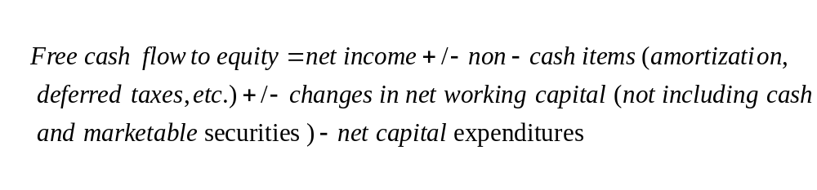
Discounted Cash Flow Analysis
Free Cash Flow to Equity
[ 15-2]

Slide 48
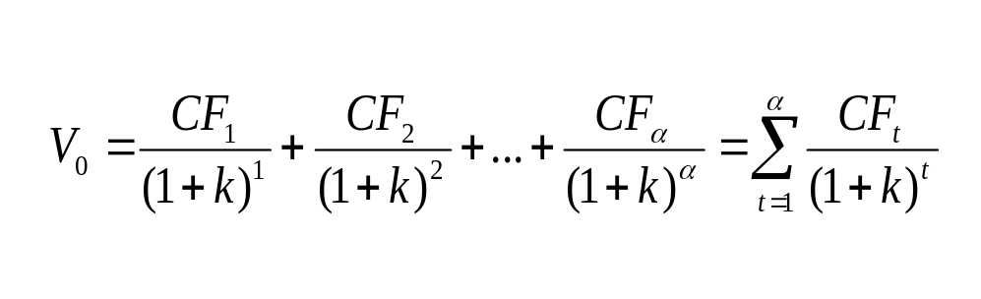
Discounted Cash Flow Analysis
The General DCF Model
Equation 15 – 3 is the generalized version of the DCF model showing how forecast free cash flows are discounted to the present and then summed.
[ 15-3]

Slide 49
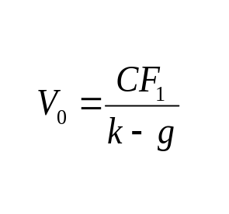
Discounted Cash Flow Analysis
The Constant Growth DCF Model
Equation 15 – 4 is the DCF model for a target firm where the free cash flows are expected to grow at a constant rate for the foreseeable future.
Many target firms are high growth firms and so a multi-stage model may be more appropriate.
(See Figure 15 -3 on the following slide for the DCF Valuation Framework.)
[ 15-4]

Slide 50
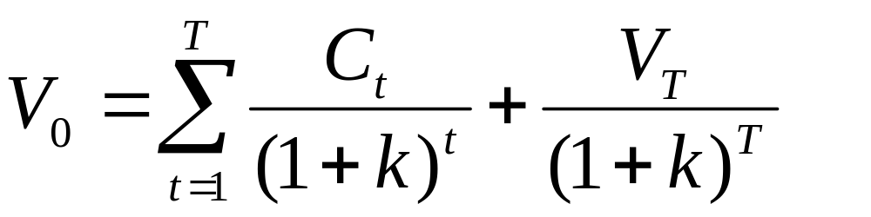
Valuation Issues
Valuation Framework
15-3 FIGURE
Time Period
Free Cash Flows
Terminal Value
Discount Rate

Slide 51
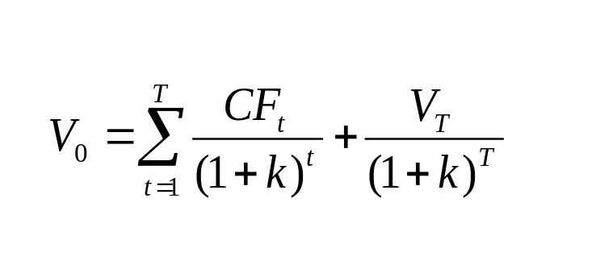
Discounted Cash Flow Analysis
The Multiple Stage DCF Model
The multi-stage DCF model can be amended to include numerous stages of growth in the forecast period.
This is exhibited in equation 15 – 5:
[ 15-5]

Slide 52
Valuation Issues
The Acquisition Decision and Risks that Must be Managed
Once the value to the acquirer has been determined, the acquisition will only make sense if the target firm can be acquired at a price that is less.
As the acquirer enters the buying/tender process, the outcome is not certain:
    Competing bidders may appear
    Arbs may buy up outstanding stock and force price concessions and lengthen the acquisition process (increasing the costs of acquisitions)
    In the end, the forecast synergies might not be realized
  The acquirer can attempt to mitigate some of these risk through advance tax rulings from CRA, entering a friendly takeover and through due diligence.

Slide 53
Valuation Issues
The Effect of an Acquisition on Earnings per Share
An acquiring firm can increase its EPS if it acquires a firm that has a P/E ratio lower than its own.

Slide 54

Accounting Implications of Takeovers
Mergers and Acquisitions

Slide 55
Accounting for Acquisitions
Historically firms could use one of two approaches to account for business combinations
    Purchase method and
    Pooling-of-interest method (no longer allowed)
  While more popular in other countries, the pooling of interest is no longer allowed by:
    CICA in Canada
    Financial Accounting Standards Board (FASB) in the U.S. and
    Internal Accounting Standards Board (IASB)

Slide 56
Accounting for Acquisitions
The Purchase Method
One firm assumes all assets and liabilities and operating results going forward of the target firm.
How is this done?
All assets and liabilities are expressed at their fair market value (FMV) as of the acquisition date.
If the FMV > the target firm’s equity, the excess amount is goodwill and reported as an intangible asset on the left hand side of the balance sheet.
Goodwill is no longer amortized but must be annually assessed to determine if has been permanently ‘impaired’ in which case, the value will be written down and charged against earnings per share.

Slide 57
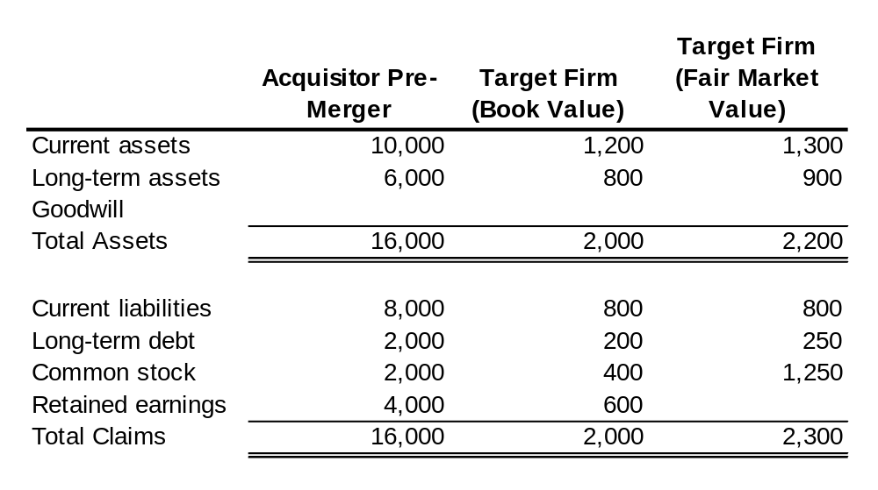
Example of the Purchase Method
Accounting for Acquisitions
Acquisitor purchases Target firm for $1,250 in cash on June 30, 2006.

Slide 58
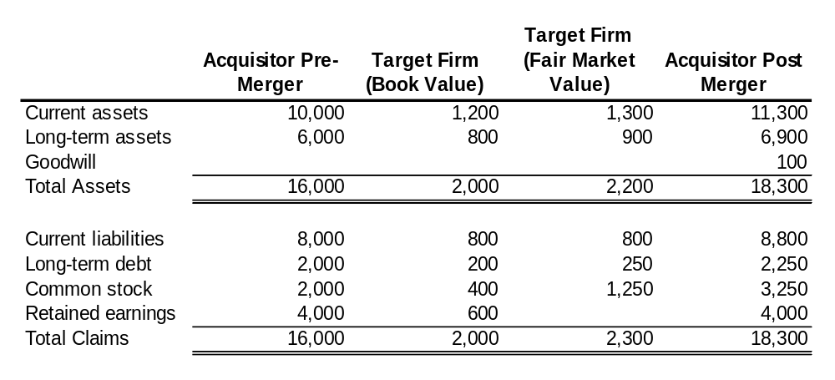
Example of the Purchase Method
Accounting for Acquisitions
Acquisitor Value pre merger + Target Firm (FMV) = Acquisitor Post Merger
Goodwill = Price paid – MV of Target firm Equity
= $1,250 – (MV of target assets – MV of target Liabilities)
= $1,250 – ($2,200 - $1,050)
= $100
Book Values are not relevant.

Slide 59
Good Will in Subsequent Years
The Purchase Method
Good will is subject to an impairment test each year.
This will require FMV estimating using discounted cash flow approaches annually following the acquisition and capitalization of good will on the balance sheet.
Good will is changed only if it is ‘impaired’ in subsequent years resulting in a write down and a charge against earnings.

Slide 60
Summary and Conclusions
In this chapter you have learned:
  The various forms of business combinations
  The common motives that exist for takeovers as well as the desirable characteristics of potential takeover “targets”
  How to evaluate a potential takeover candidate using the multiples approach and using discounted cash flow analysis
  How acquisitions should be accounted for in the financial statements including the impact that acquisitions can have on EPS.

Slide 61

Concept Review Questions
Mergers and Acquisitions

Slide 62
Concept Review Question 1
Acquisition versus Merger
What is the difference between an acquisition and a merger?

Slide 63
Copyright
Copyright © 2007 John Wiley & Sons Canada, Ltd. All rights reserved. Reproduction or translation of this work beyond that permitted by Access Copyright (the Canadian copyright licensing agency) is unlawful. Requests for further information should be addressed to the Permissions Department, John Wiley & Sons Canada, Ltd. The purchaser may make back-up copies for his or her own use only and not for distribution or resale. The author and the publisher assume no responsibility for errors, omissions, or damages caused by the use of these files or programs or from the use of the information contained herein.

